Slide 1

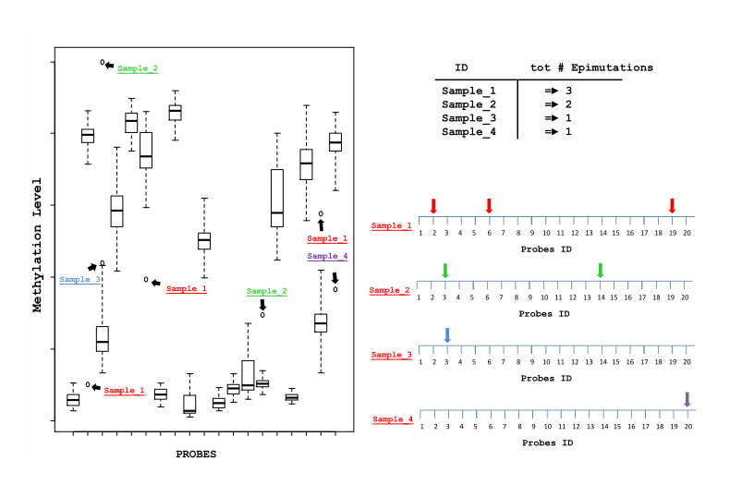
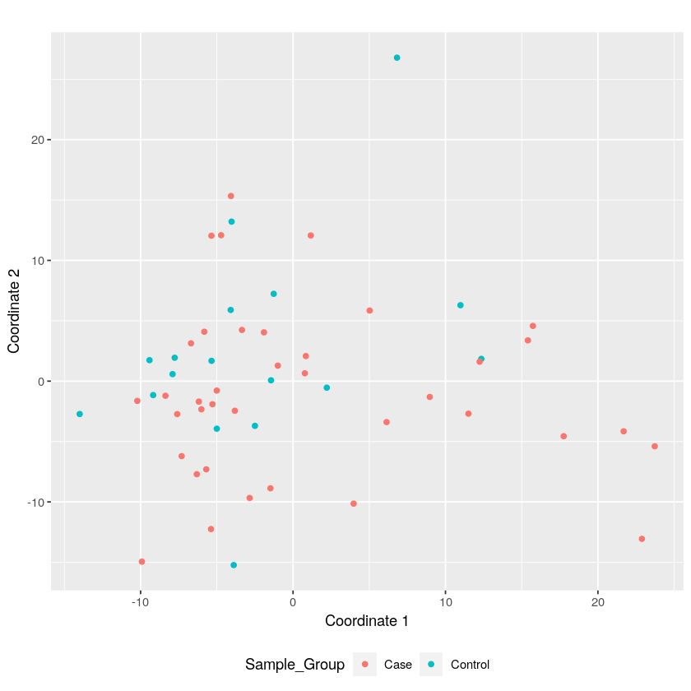
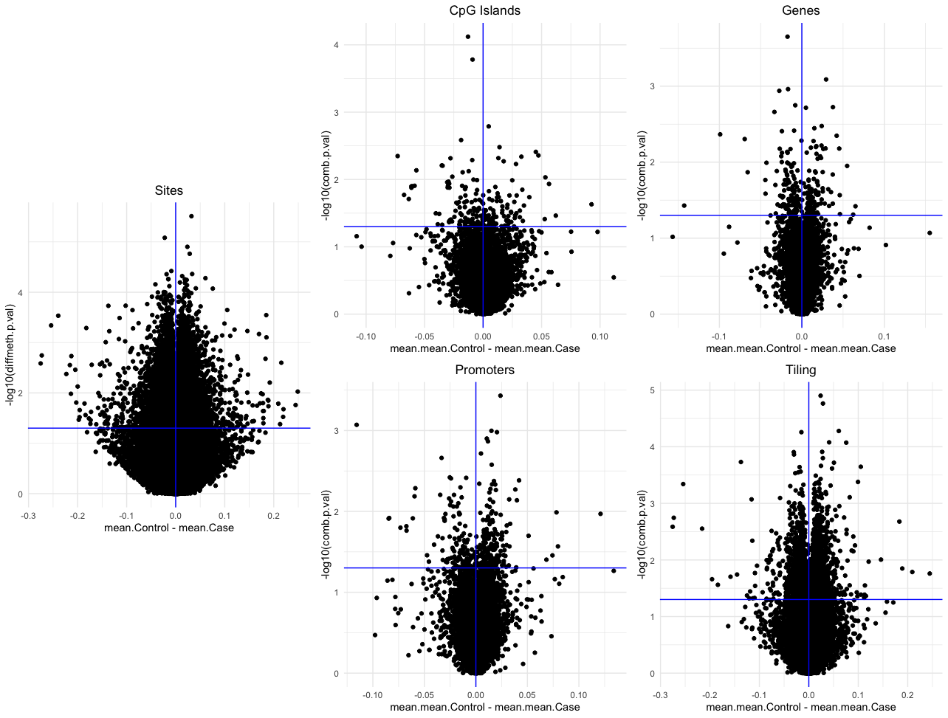
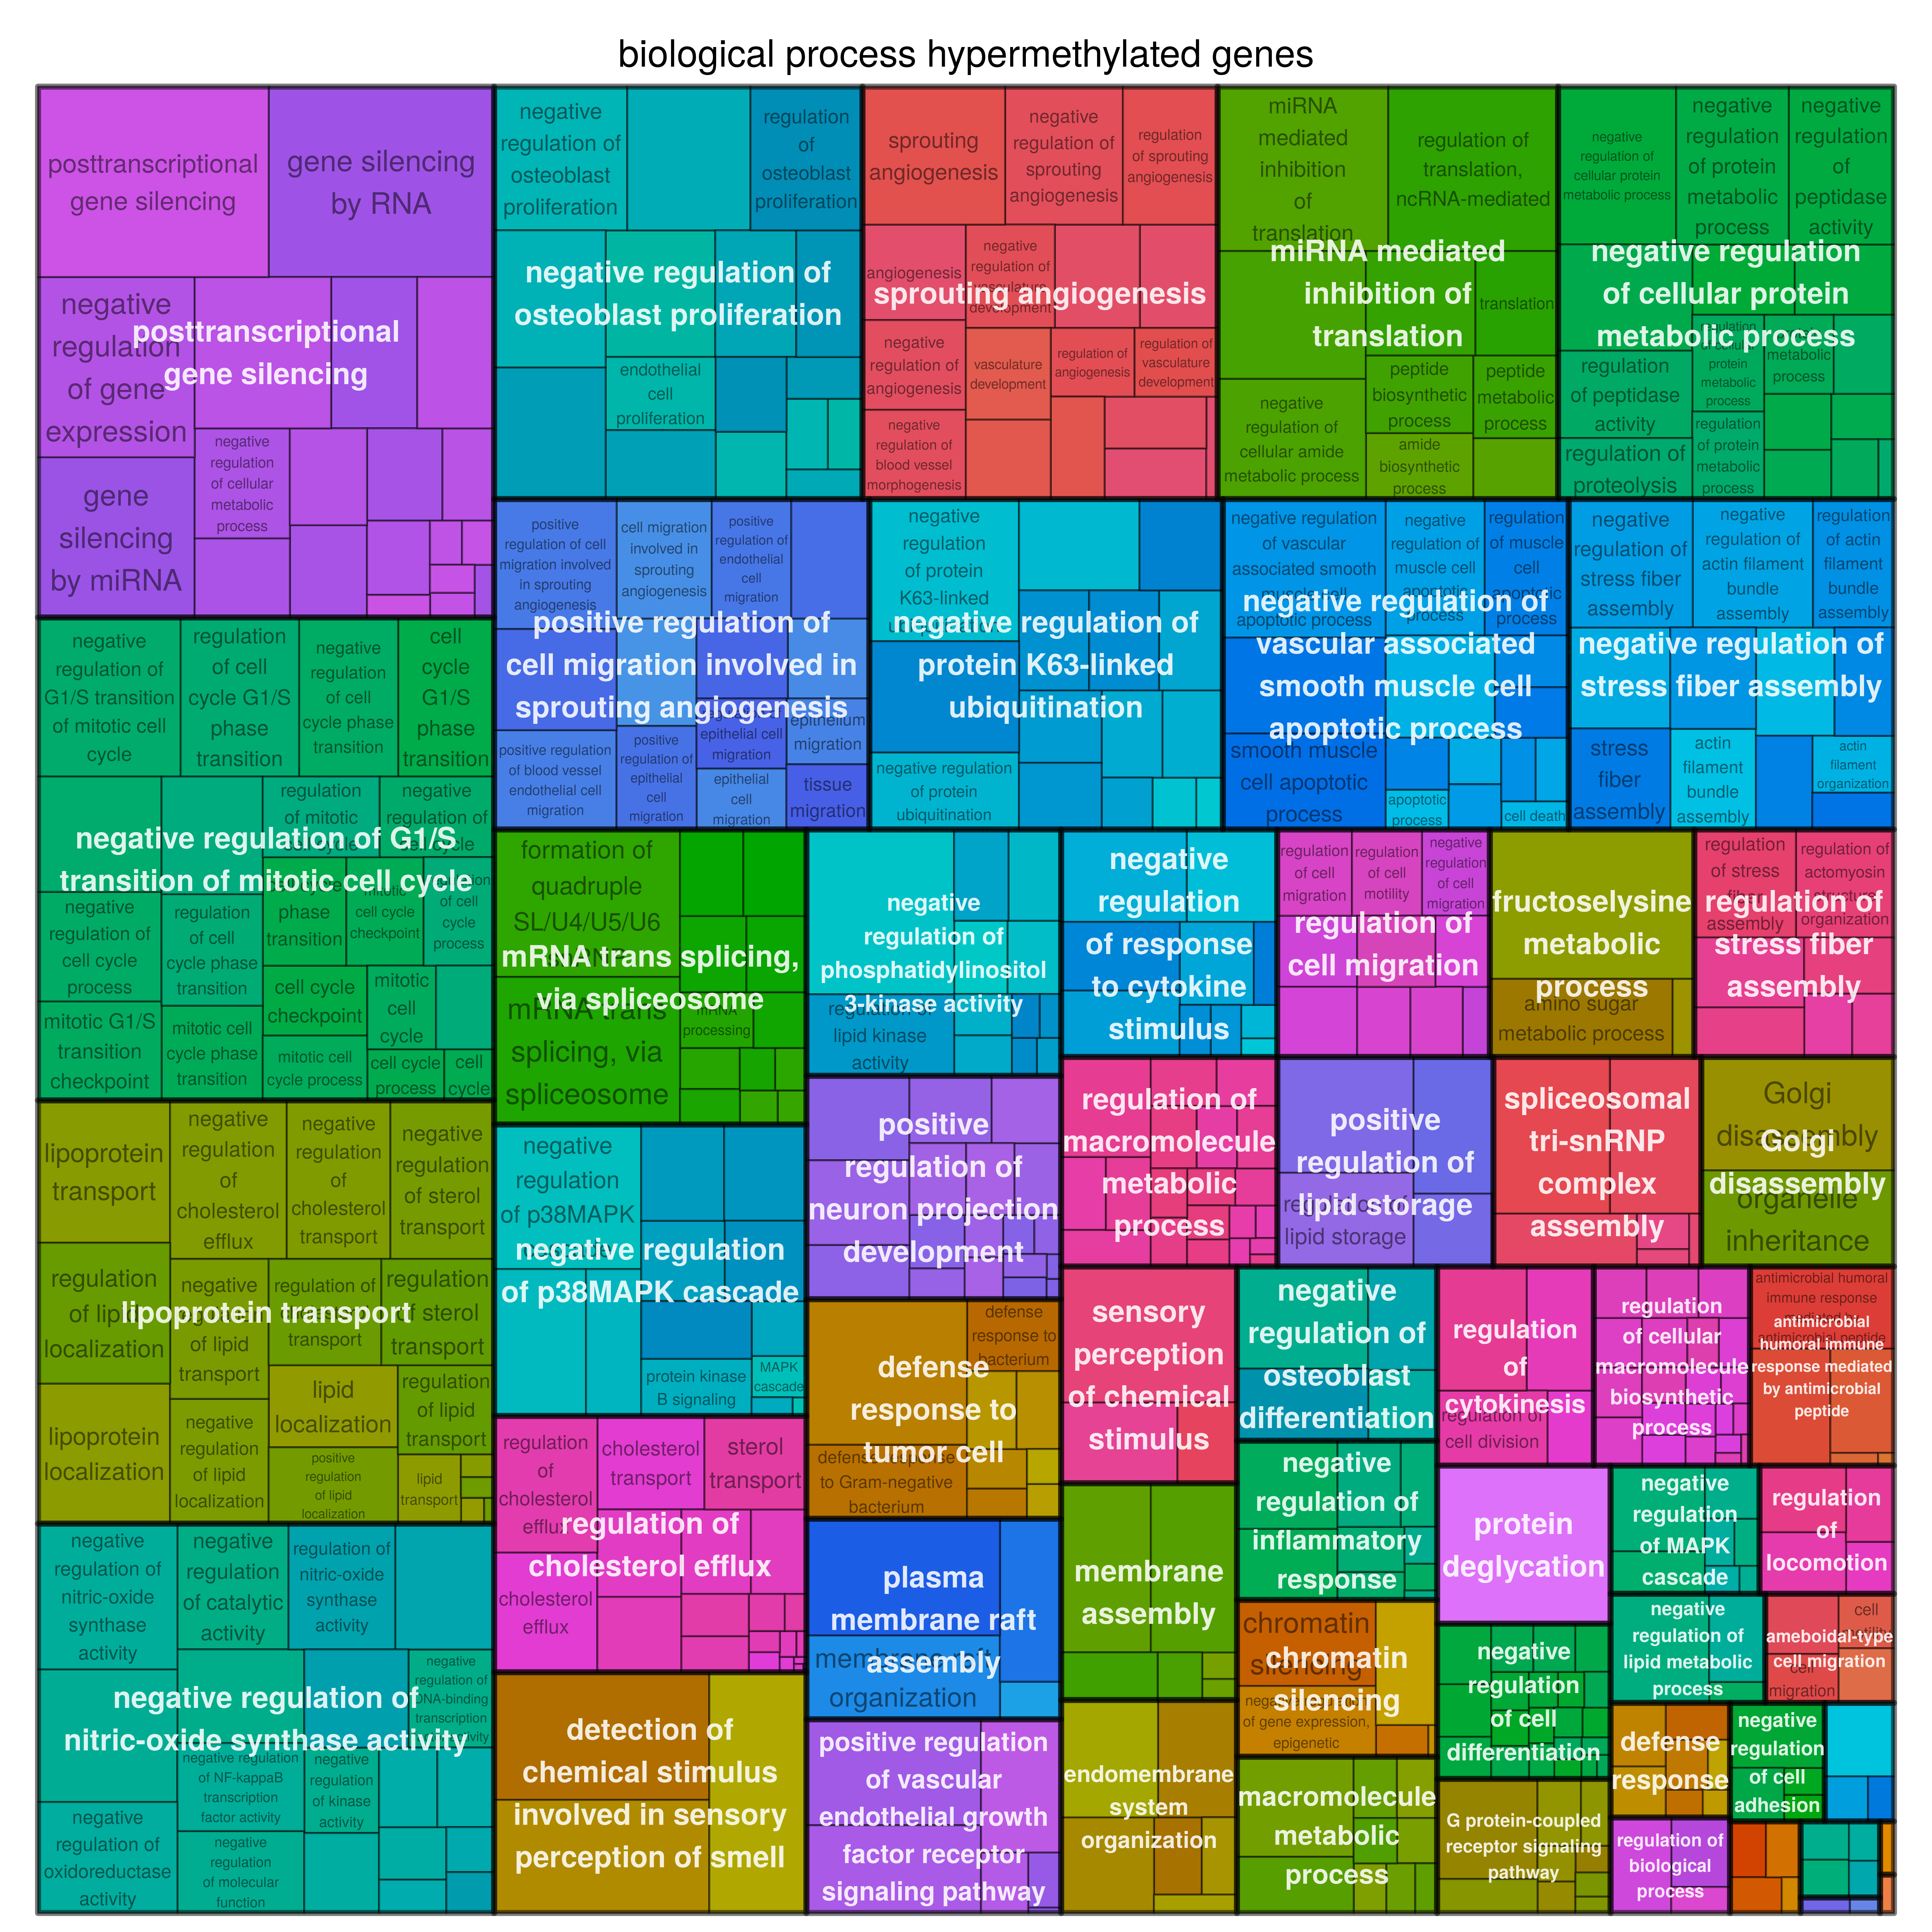
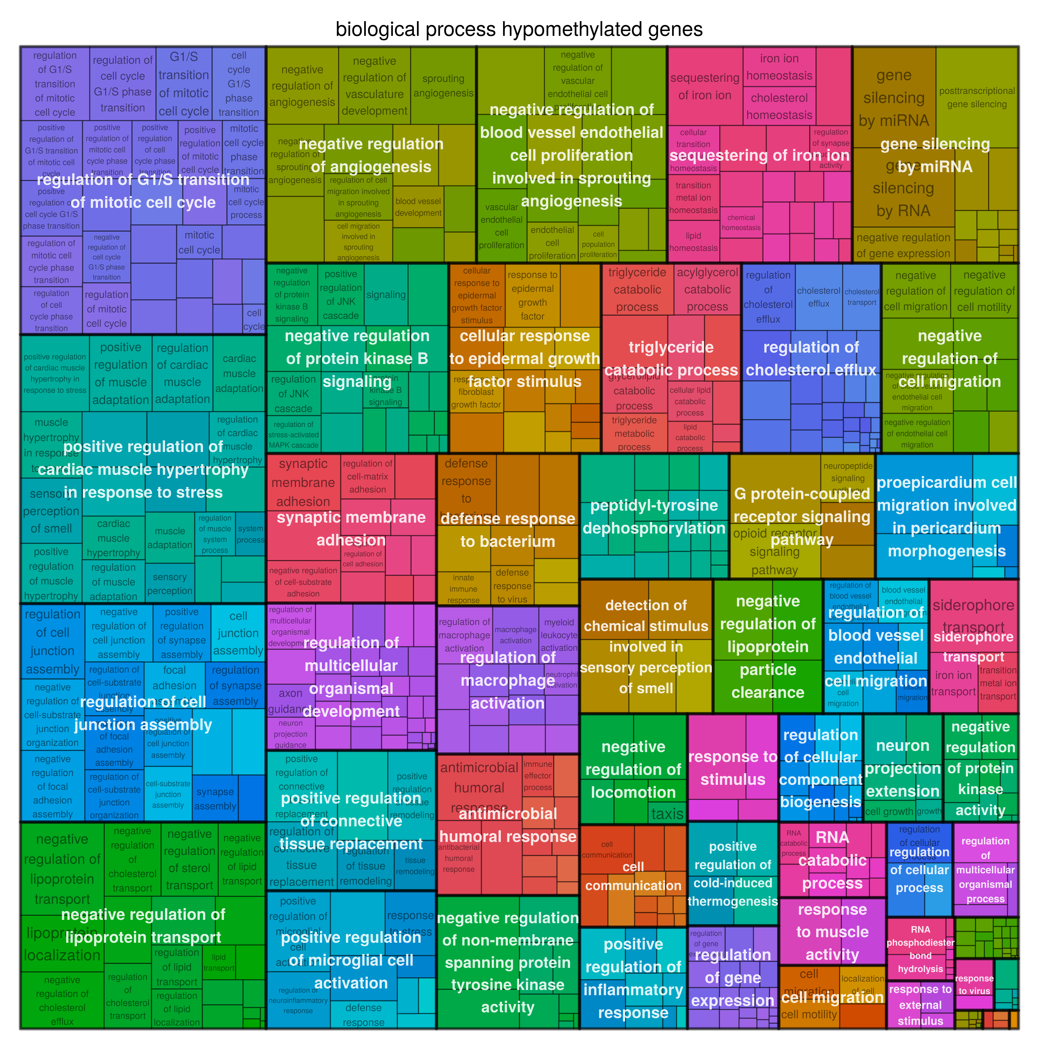
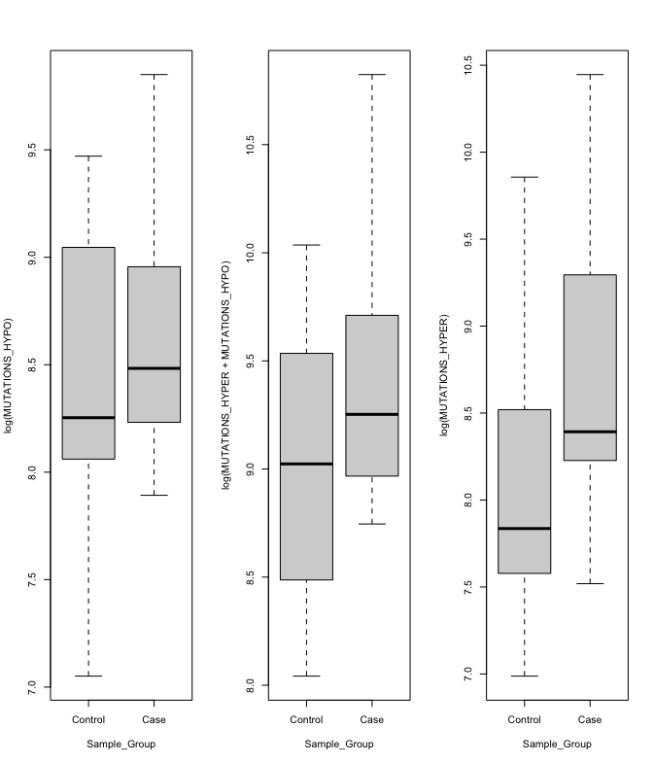
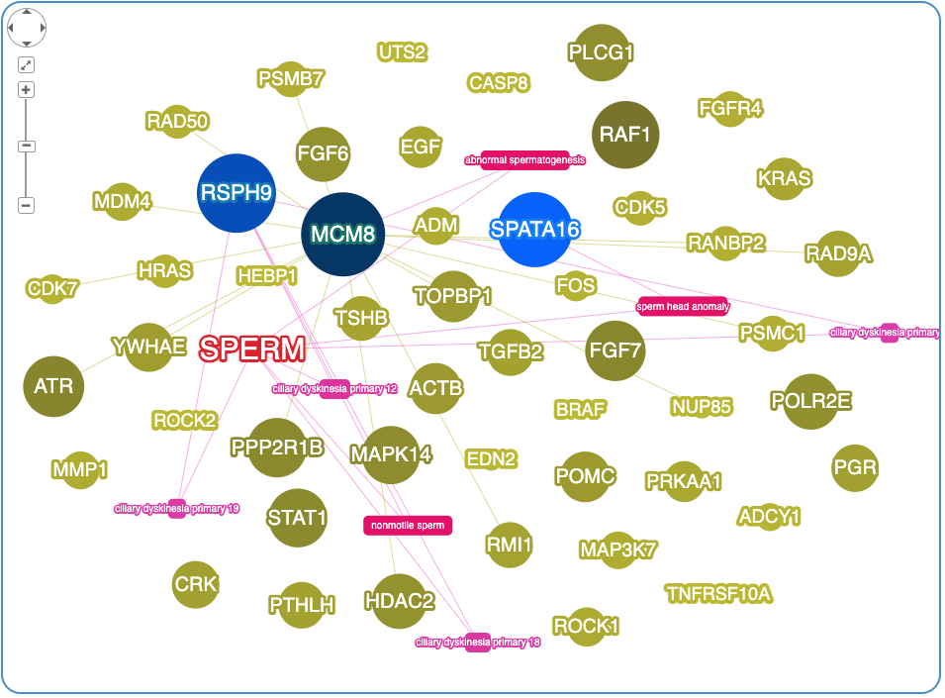

Preliminary analysis of epigenetic effects on adults conceived by mothers exposed to dioxin.
Author names: Luigi Corsaro(1), Stefano Signorini(2), Paolo Brambilla(2), Paolo Mocarelli(2), Davide Gentilini(1)
(1) Department of Brain and Behavioural Sciences, University of Pavia, 27100 Pavia, Italy. (2) Department of Laboratory Medicine, University of Milano-Bicocca, School of Medicine, Hospital of Desio, Desio-Milano, Italy.
Background
Abstract
The dioxin exposure impact has been studied to be associated with a series of effects on the developmental process that is correlated with reproductive problems particularly on breastfed infants. The Seveso disaster left many adults in the fertile age range exposed to the dioxin, we aimed to investigate the effect of dioxin to child conceived years later by mother exposed to the dioxin.
Epigenome and exposome interaction is an interesting field of investigation, to understand the underlying mechanism of regulation. This study evaluates the effect of dioxin (TCDD) on the DNA methylation on offspring, due a pregnancy done by a mother exposed to the dioxin years before the conception, some of the cases were breastfed.
We used the Illumina 850K (EPIC) array to measure the genome wide DNA methylation in whole blood obtained from 38 adult men exposed and 17 adult men not exposed. The inferred age calculated with the Hannum markers was used as covariate. The analysis was conducted using two different techniques the first technique addressed the
differential methylation level between the two groups (exposed and not exposed); the second technique studied epigenetic drift and investigated genomic areas with extreme outlying values of methylation (Stochastic epigenetic Mutations (SEMs))
Differential methylation analysis was performed both at site and region level, the most important signals raised out from the 100 top ranked genes belonging to interesting biological process for the hypermethylated probes, the outcome pointed out to an impact on the angiotensin-renin pathway (confirmed by the literature).
The SEMs analysis revealed that the burden of SEMs resulted significantly higher in the exposed group for the mutations with hyper methylation.
In conclusion outcomes confirm a variation of the DNA methylation of the exposed samples, the differential analysis and the epi stochastic mutation outcomes pointed to a general increase of the epigenetic drift, sign of an altered epigenome.
Introduction
Many are the cases of dioxin exposure due to pollutant (1) or to use of chemical artifact, the exposure to dioxin che be through ingestion in food, pollution or exposure by accident, many studies focused on impact of exposure to the exposed organism we studied the effect of exposure to the offsprings’s exposed. The dioxin impact on methylation was hypothesysed untile thw 1989 Shen E.S. (2) et al. Amny studies focuse on the effect of TCDD over the exposed organism following incident, pollution and or misuse as the orange agent usage.
Aim
The primary is to investigate any relation between the TCDD exposure of the mothers and the impact on the methylome’s offsprings, morover the impact of changes in the methylation levels to the sperm quality and production. As a secondary outcome we will investigate the impact of breast feeding on methylome on offsprings’ sperm quantity.
Materials and Method
We studied a cohort of 55 young man, 38 offsprings of exposed mothers and 17 of not exposed mother. The phenotypyc trait available were the sperm count and the quantity or modality of the mother exposure (dose of tcdd, how much time before the conception the mother was exposed, breas feeding of the child). We used the Infinium Methylation 850K Beadchip array to measure the methylation profile. The raw data were pre-processed with the ChAMP R package producing a dataset of 55 samples and 739014 probes. A quantile normalization using preprocesCore was applied. The biological age, the grim age and the cell type composition were with the service at URL: https://dnamage.genetics.ucla.edu/new.(5)
The SEM (stochastic epigenetic mutations) were computed using the package SemSeeker available on https://github.com/drake69/semseeker.
The package calculate the medians and quartile methylation of a reference population afterward identifies the outliers defined as the values outside range 1st to 3rd quartile. The following phase is to conduct a test for the over-representation of the outliers probes, the test is performed using a sliding window and the hypergeometric cumulative function, the outcome is the number of genomic regions that were enriched in SEMs.
mutations
sliding window
Figure 1 –Outlier probes calculation
Figure 2 -Enrichments per genomic regions
Results
1st Method - Differential methylation:
Was adopted a complementary methylation analysis strategy, previously described by Gentilini et al. [3,4]. The methylation profile was obtained using the Infinium Methylation 450K Beadchip technology. The primary information for our cohort is the sperm count, it resulted significatively different between exposed and not exposed (p.adj 0.05) and between breastfed and not breast fed (p.adj 0.03) and TCDD’s exposure of the mother over 26.85 (p.adj 0.03). The cohort is constitued by 55 young males of median age 23.09. The immune system was not affected by the exposition’s dose grater than 26.85, the brest fed or the expostion at all. Also the biological age and the age acceleration were not signifiantly impacted by the dioxin exposure.
We used an integrated workflow to identify differentially methylated region using the RnBeads and Champ packges. The multidimension scaling was conducted at sites level to verify that no technical bias was introduced. No clustering of samples can be observed along the 1st and the 2nd component. We used the Differential Methylation module of RnBeads without any covariate.
Were not found sites, genes or promoters with an adjusted p-value significative, so we focused on the nominal p-value founding many sites and tiling regions with a difference over |10%| and few genes and promoters with difference in mean methylation more than |10%| as in the volcano plot figure.
Annotations and prioritization:
The mutated CpGs were annotated to the genes and prioritised using the GO Enrichment Analysis via RnBeads by using an algorithm (GOstats) based on a hypergeometric test and the hierarchical structure of the gene ontology database, a treemap of the impacted pathway was represented using rrvgo. (6)
The gene ontology didn’t evidenced any relation with the male reproductive system or sperm quantity, but highligts an impact on the angiogenesis pathway both for the hypermethylated and hypomethylated genes as in treemap on the right.
Supplementary materials at:
Treemap hypermethylated genes’ pathway
Treemap hypomethylated gene’s pathway
2nd Method - Stochastic Epigenetic Mutations (SEM):
The burden of SEM was calculated as described in the methods, afterwards were computed the zones enriched in mutation qualifing thoise as lesions. The retained probes with a mutation were counted and compared between exposed and not exposed. The outcome was computed transforming the total burden with natural log to normalize the distribution and apply the t-test with a significative p-value, the mutations due hypermethylation are 1.54 times in the exposed vs not exposed (p-value 0.02) the hypomethylated probes are 1.47 times in the exposed (p- value 0.05) while the total load of mutations due the hyper and hypo methylation is 1.50 time in the case vs the control (p-value 0.03).
Genes enriched in hypo-methylated SEVs are numerically greater than hyper-methylated ones: the most frequent deregulated loci are XXXX involving two cases each.
Annotations and prioritization:
The mutated CpGs were annotated to the genes and prioritised using the Phenolyzer
with a list of HPO from the https://hpo.jax.org web site using the term sperm, we
obtained a list of 34 terms used to query Phenolizer through the perl api.
Were computed the burden’s mutations per each genes belonging to the pathway
and the 1000 st gene prioritized used to draw a network map of the pathway.
Discussion
This study represents the first epigenetic investigation on DNA methylation in offsprings of mother exposed to TCDD-dioxin. In conclusion outcomes confirm a variation of the DNA methylation of the exposed samples, the differential analysis and the epi stochastic mutation outcomes pointed to a general increase of the epigenetic drift, sign of an altered epigenome. The recognition of a different DNA methylation pattern in the offspring's of exposed mother and relation with the sperm pathway provide a suggestive idea that the indirect exposure to the dioxin through the female parents produce a change in the epigenome of the offspring. The interesting results also suggests to increase the number of samples and collecting also other phenotypic traits about sperm quality.
References
(1) Dioxin-like compound exposures and DNA methylation in the Anniston Community Health Survey Phase II Gary S. Pittman a,1, Xuting Wang a, Michelle R. Campbell a, Sherry J. Coulter a, James R. Olson b, Marian Pavuk c, Linda S. Birnbaum a, Douglas A. Bell a,⁎
(2) The Potential Role of DNA Methylation in the Response to 2,3,7,8-Tetrachlorodibenzo-p-dioxin* Emily S. Shen and James P. Whitlock, Jr. From the Department of Pharmacology, Stanford Uniuersity Schoolof Medicine, Stanford, California 94305-5332
(3) Gentilini, D.; Garagnani, P.; Pisoni, S.; Bacalini, M.G.; Calzari, L.; Mari, D.; Vitale, G.; Franceschi, C.; Di Blasio, A.M. Stochastic epigenetic mutations (DNA methylation) increase exponentially in human aging and correlate with X chromosome inactivation skewing in females. Aging 2015, 7, 568–578.
Gentilini, D.; Somigliana, E.; Pagliardini, L.; Rabellotti, E.; Garagnani, P.; Bernardinelli, L.; Papaleo, E.; Candiani, M.; Di Blasio, A.M.; Viganò, P. Multifactorial analysis of the stochastic epigenetic variability in cord blood confirmed an impact of common
Horvath, S. DNA methylation age of human tissues and cell types. Genome Biol. 2013, 14, R115.
Falcon, S.; Gentleman, R. Using GOstats to test gene lists for GO term association. Bioinformatics 2006, 23, 257–258.
Contacts and Citations
Luigi Corsaro
luigi.corsaro01@universitadipavia.it
https://github.com/drake69
Davide Gentilini
davide.gentilini@unipv.it
Citations:
R, RnBeads, ChAMP, rrvgo, phenolyzer
WCS Wellcome connecting Science Conference 2021 november

